Slide 1

Using Machine Learning to predict Drug-Drug Interactions by integrating drug properties
Raghav Krishnaswamy

Slide 2
Purpose
I am using machine learning to predict drug-drug interactions by integrating different drug properties. I will be integrating drug phenotypic, chemical, genomic, therapeutic properties, dosage/strength, length of application, and structural similarity. A model will be created from this in order to help predict drug-drug interactions in the future. This will greatly help reduce healthcare costs as well as save lives and morbidity.

Slide 3
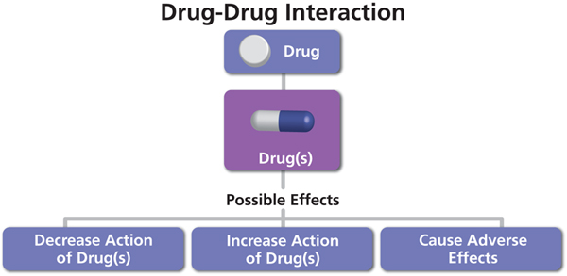
Why this is important
Drug-Drug Interactions are a reason for increased healthcare cost
Adverse reactions found after clinical testing caused drugs to no longer be in use
Wastes much time and money (Can cause patients up to 22% more.(Aegis Labs, n.d))
Drug-Drug interactions can potentially harm people and end lives
Interactions not found in the lab could be harmful
Could result in permanent harm or be fatal
DDIs often lead to patient morbidity and mortality
Accounts for 3-5% of all inpatient medication errors (Cheng,2014)
New Diseases results in new Drugs as Cures
Without a model it takes much time for lab testing of DDIs
This time lost may cost lives

Slide 4
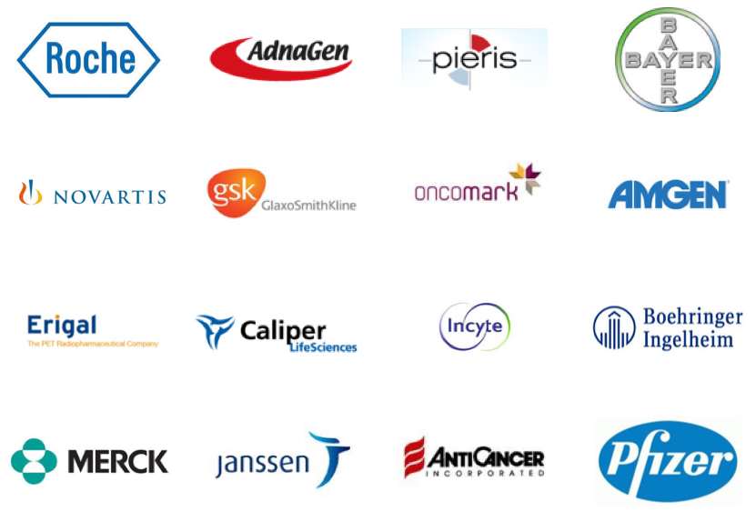

Why it matters and Who cares
Pharmaceutical Companies
Will save them much money from future research and development
Save their reputation
The Public
For Health and Safety
To prevent unnecessary deaths or injuries

Slide 5

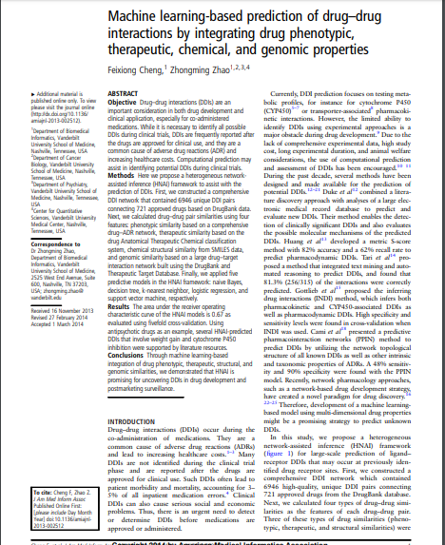
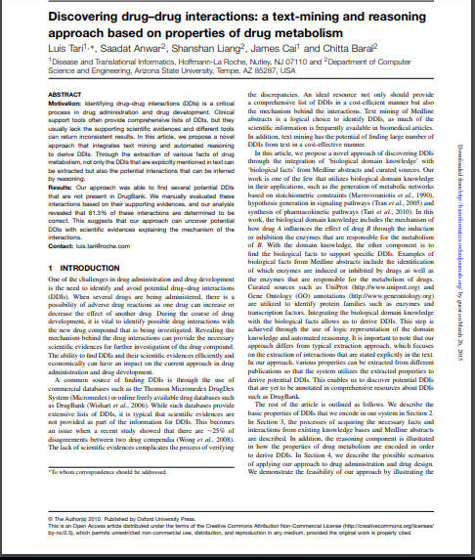



Present Research and how mine is Different

Slide 6
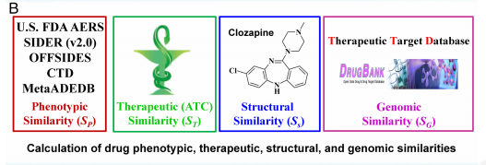
Method
Create a Heterogenous Network assisted inference framework which will help with large scale prediction of DDIs
Create a comprehensive DDI network which contains many unique DDI pairs based on a set of Drugs from the DrugBank Database.
Calculate different drug-drug similarities as features of every drug-drug pair utilizing different databases. Ex: Drug Phenotypic
Apply machine learning algorithms which will be predictive models for this HNAI framework
Calculate the area under the ROC curve for the models and analyze these results to determine the most accurate and efficient models as well as overall conclusions
Analyze the results of the statistical tests and the information shown by the DDI network and its graph
A network graph will then be built and statistical analysis will be done to the data. Ex: Wilcoxon test using the R platform
Multiple fold cross-validation techniques would be used to evaluate the performance of all the models

Slide 7
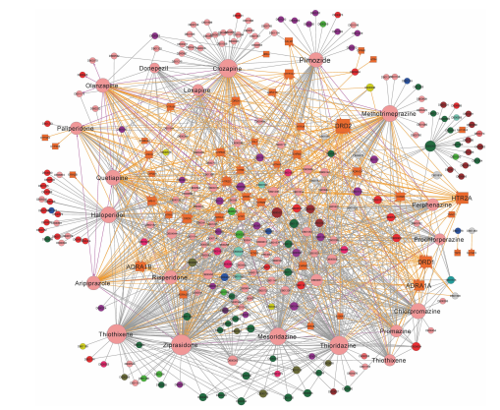
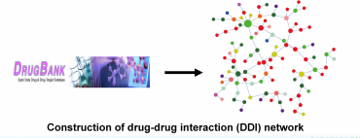
Data
Data was found from DrugBank, Therapeutic Target Database, MetaAEDB
Dosage and Length of Application were found using DrugBank
Phenotypic - Based on Drug ADR network
Therapeutic similarity based on drug anatomical therapeutic chemical classification system
Structural Similarity- chemical structural data
Genomic similarities are based on drug-target interaction network

Slide 8
References/Citations
Aegis Labs. (2018). Aegis Sciences rebrands drug interaction test to InterACT Tx. Retrieved from https://www.aegislabs.com/news/aegis-sciences-rebrands-drug-i nteraction-test-to-interact-rxtm
Cami, A., Manzi, S., Arnold, A., & Reis, B. Y. (2013). Pharmacointeraction Network Models Predict Unknown Drug-Drug Interactions. PLoS ONE, 8(4), e61468.doi:10.1371/journal.pone.0061468
Cheng, F., & Zhao, Z. (2014). Machine learning-based prediction of drug–drug interactions by integrating drug phenotypic, therapeutic, chemical, and genomic properties. Journal of the American Medical Informatics Association, 21(e2), e278– e286.doi:10.1136/amiajnl-2013-002512
Duke, J. D., Han, X., Wang, Z., Subhadarshini, A., Karnik, S. D., Li, X., et al. (2012). Literature Based Drug Interaction Prediction with Clinical Assessment Using Electronic Medical Records: Novel Myopathy Associated Drug Interactions. PLoS Computational Biology, 8(8), e1002614.doi:10.1371/journal.pcbi.1002614
Tari, L., Anwar, S., Liang, S., Cai, J., & Baral, C. (2010). Discovering drug-drug interactions: a t ext-mining and reasoning approach based on properties of drug metabolism. Bioinformatics, 26(18), i547–i553.doi:10.1093/bioinformatics/btq382

Slide 9
Image Citations
https://www.google.com/search?q=drug+drug+interaction&safe=strict&tbm=isch&source=iu&ictx=1&fir=GEaSnLz3mM6v4M%253A%252CTO9K10mkzfmDZM%252C_&vet=1&usg=AI4_-kRmCBQ95Ww562xNehCn56XC5dfj8w&sa=X&ved=2ahUKEwj7ucTFi__hAhVHhuAKHSs4A4gQ9QEwAHoECA0QCA&biw=1366&bih=625#imgrc=GEaSnLz3mM6v4M:
https://www.google.com/search?safe=strict&biw=1366&bih=625&tbm=isch&sa=1&ei=MhTMXKm2OKiKgge67YLADQ&q=pharmaceutical+companies&oq=pha&gs_l=img.1.0.35i39l2j0i67l5j0j0i67l2.16013.16831..17850...0.0..0.142.316.1j2......1....1..gws-wiz-img.a9d5-grC1mA#imgrc=o1rzIc-pFQ6L3M:
https://www.google.com/search?safe=strict&biw=1366&bih=625&tbm=isch&sa=1&ei=RRTMXIvqIvGg_Qbc07WgDA&q=public+health+and+safety&oq=public&gs_l=img.1.0.35i39j0i67l5j0j0i67j0j0i67.43590.44416..45474...0.0..0.73.417.6......1....1..gws-wiz-img.YwUlKWdoLJg#imgrc=2Jmrblo6buhGJM:
https://www.google.com/search?safe=strict&biw=1366&bih=625&tbm=isch&sa=1&ei=cxTMXLSlOcGt_QbK3ofwDg&q=machine+learning+model+to+predict+drug-drug+interactions&oq=machine+learning+model+to+predict+drug-drug+interactions&gs_l=img.3...339979.352655..354940...16.0..0.137.4662.63j2......1....1..gws-wiz-img.....0..35i39j0j0i67j0i5i30j0i24.frfwEEyPyJQ#imgrc=LBQRloMEQhr9nM:

